Slide 1

INDIAN AIRFORCE: ORGANISATION
THE INDIAN AIR FORCE HAS SEVEN COMMANDS, OF WHICH FIVE ARE OPERATIONAL AND TWO ARE FUNCTIONAL
HQ CENTRAL AIR COMMAND, ALLAHABAD (OPERATIONAL)
HQ EASTERN AIR COMMAND, SHILLONG (OPERATIONAL)
HQ WESTERN AIR COMMAND, NEW DELHI (OPERATIONAL)
HQ SOUTHERN AIR COMMAND, THIRUVANANTHAPURAM (OPERATIONAL)
HQ SOUTH-WESTERN AIR COMMAND, GANDHI NAGAR (OPERATIONAL)
HQ MAINTENANCE COMMAND, NAGPUR (FUNCTIONAL)
HQ TRAINING COMMAND, BANGALORE (FUNCTIONAL)

Slide 2
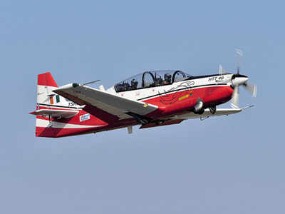
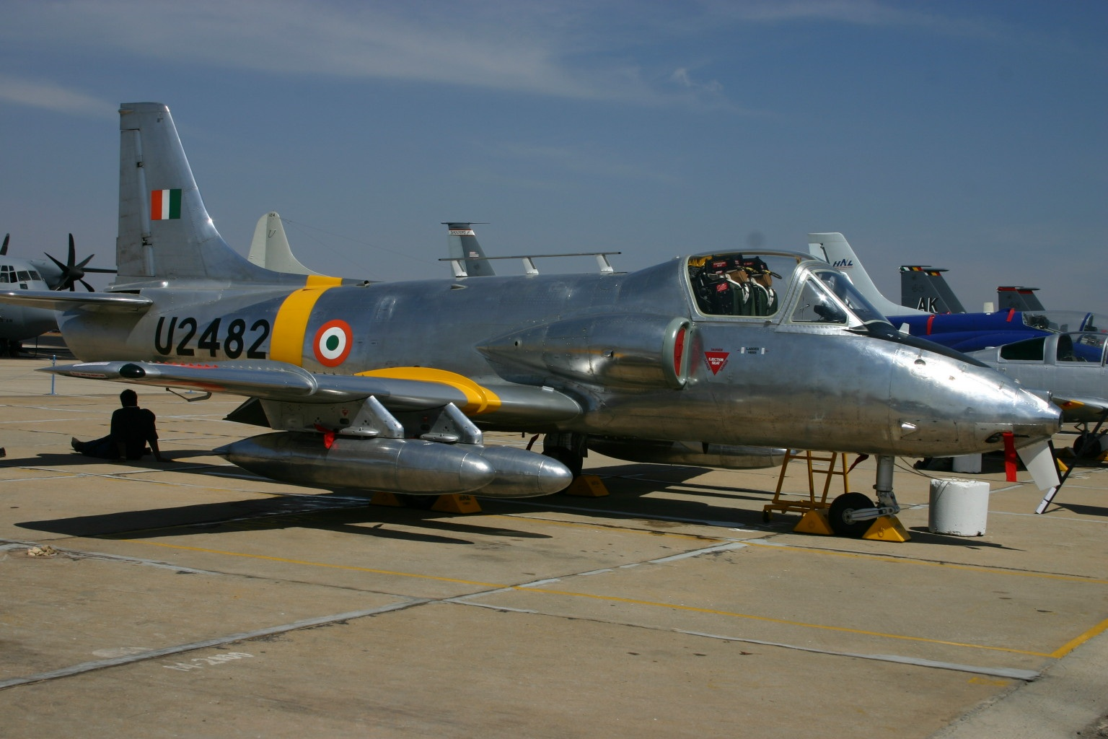
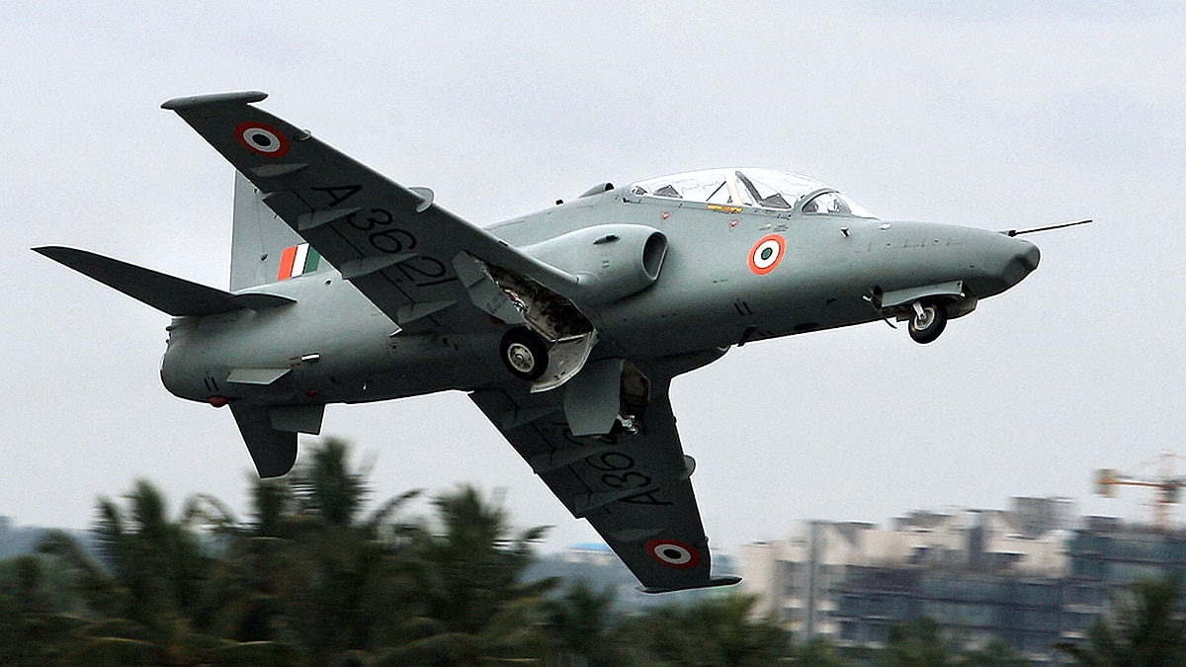
IAF TRAINING
Air Force Academy (AFA)
TRAINER AIRCRAFT
DUNDIGUL
43 KM FROM HYDERABAD
STAGE I
ESTABLISHED 1971
# PC-7 MK-11 PILATUS ( SWEDISH ORIGIN).
TURBOPROP AIRCRAFT.
# GOVERNMENT HAS APPROVED PURCHASE OF 70 HINDUSTAN TURBO TRAINER (HTT) -40 BASIC TRAINER AIRCRAFT. DEVELOPED BY HAL. INDUCTION OVER 06 YEARS.
STAGE II
KIRAN HJT 36 (IJT) MK II. DEVELOPED BY HAL.
STAGE III
HAWK 132 (ADVANCE JET TRAINER).
BAE SYSTEMS HAWK IS A BRITISH SINGLE-ENGINE, JET-POWERED ADVANCED TRAINER AIRCRAFT

Slide 3
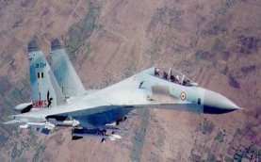
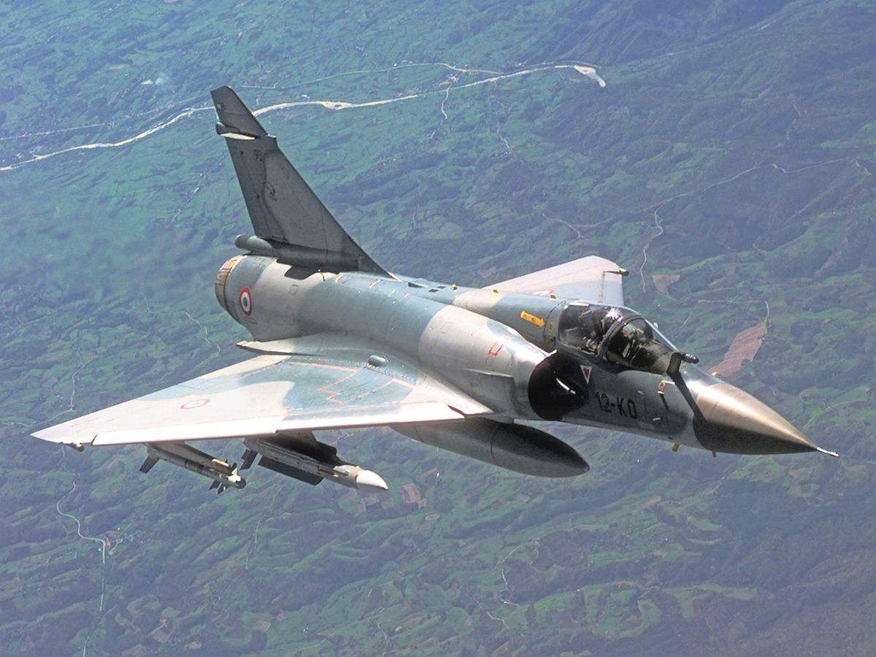
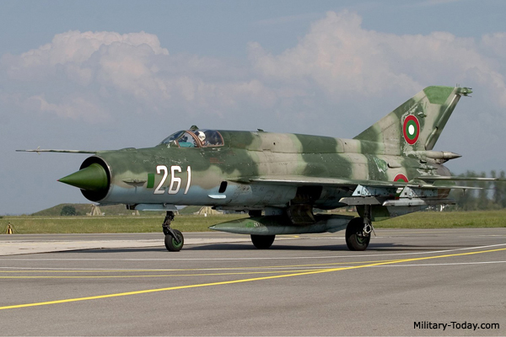
FIGHTER AIRCRAFT: IAF
SUKHOI 30
TWIN SEATER TWIN ENGINE MULTIROLE FIGHTER OF RUSSIAN ORIGIN .
MAXIMUM SPEED OF 2.35 MACH.
TITLE 01
MIRAGE 2000
A SINGLE SEATER OF FRENCH ORIGIN POWERED BY A SINGLE ENGINE .MAX SPEED OF MACH 2.3.
AIR DEFENCE AND MULTI-ROLE FIGHTER
EFFECTIVELY EMPLOYED IN KARGIL FOR PRECISION BOMBING
MIG 21
MIKOYAN-GUREVICH (MIG-21) IS A FIGHTER AND INTERCEPTOR AIRCRAFT OF RUSSIAN ORIGIN
INDUCTED IN OCT 63
AGEING AIRCRAFT. 292 ACCIDENTS ( FLYING COFFIN.

Slide 4

FOR MORE KNOWLEDGE ON THE SUBJECT
JOIN “ SHAURYA”

